Slide 1

FOSSCOM 2016
Big Data
Streaming processing
using
Apache Storm‏

Slide 2
Agenda
Big Data concepts
Batch & Streaming processing
NoSQL persistence
Apache Storm and Apache Kafka
Streaming application demo
Considerations on Big Data applications

Slide 3

Who we are?
Adrianos Dadis (@qiozas )
Patroclos Christou
Eleftheria Chavelia
Sofia Nomikou

Slide 4
Big Data characteristics
Variety
Structured
Unstructured
Semi-structured
All the above
Terabytes
Records
Transactions
Files
Batch
Real-time
Streams
Near-real-time
Volume
Velocity
Notes:
Volume: Big data implies enormous volumes of data.
Velocity: speed at which the data is created, stored, analysed and visualized
Variety: refers to the many sources and types of data both structured and unstructured.
Variance: Big Data Veracity refers to the biases, noise and abnormality in data
By 2020 analysts predict the amount of data will be 50x what it is today.
Every 2 days we create as much information as we did from the beginning of time up to 2003.
Smartphones (GPS & Intenet)
Sensors
Social network adoption

Slide 5
Use cases
360-degree customer view
Internet of Things
Data warehouse optimization
Information security
Sentiment analysis
Urban Planning (MIT)

Slide 6
Big Data Pros
Better user experience
Predictive analytics
Answer complex business questions
Notes:
Suggestions
Failure is immediately visible
Fast response or learn info

Slide 7
Big Data Cons
Privacy
False truths
Strict personalized content
Notes:
Snowden
Police on doorstep
“baseball bat” -> baseseball glove / balaclava
Location info
Facebook has the power to control your emotions

Slide 8
Databases
Persistency & Concurrency
Relational Databases provide strong benefits
Relational Databases pitfalls:
  Application development productivity
  Large-scale data
    Capture more data
    Process data faster
    Costs
Notes:
Persistence, Concurrency, SQL
Effort is spent on mapping data between in-memory data structures and a relational database
Polyglot Persistence

Slide 9
NoSQL
Schema agnostic
Nonrelational
Commodity hardware
Highly distributable
NOT a silver bullet
Notes:
NoSQL provides solutions on hard problems
Polyglot Persistence

Slide 10
NoSQL & CAP theorem
Consistency
  all nodes see the same data at the same time
Availability
  a guarantee that every request receives a response about whether it succeeded or failed
Partition tolerance
  the system continues to operate despite arbitrary partitioning due to network failures
CP or AP
Notes:
Eric Brewer
Write-write / read-write conflict
pessimistic preventing conflicts from occurring; optimistic lets conflicts occur
Replication makes it much more likely to run into write-write conflicts
ACID (Atomicity, Consistency, Isolation, Durability)
Shopping-cart/financial review
Sacrifice durability: telemetric data

Slide 11
NoSQL Data Models
Key Value
  Riak, Redis, Aerospike
Document
  MongoDB, Elasticsearch
Column Family
  Cassandra, HBase
Graph
  Neo4J, ArangoDB, OrientDB
Notes:
Graph: nodes=entities, edges=relationship, properties
Athina likes Apple, Athina childOf George
Update traversing without change nodes or edges. Edges are persisted

Slide 12
Apache HBase features
Schema-less
Linear and modular scalability
Strictly consistent reads and writes
Transaction only per row
No secondary indexes
Automatic and configurable sharding of tables
Automatic failover support between RegionServers
On top of HDFS
Easy to use Java API for client access

Slide 13
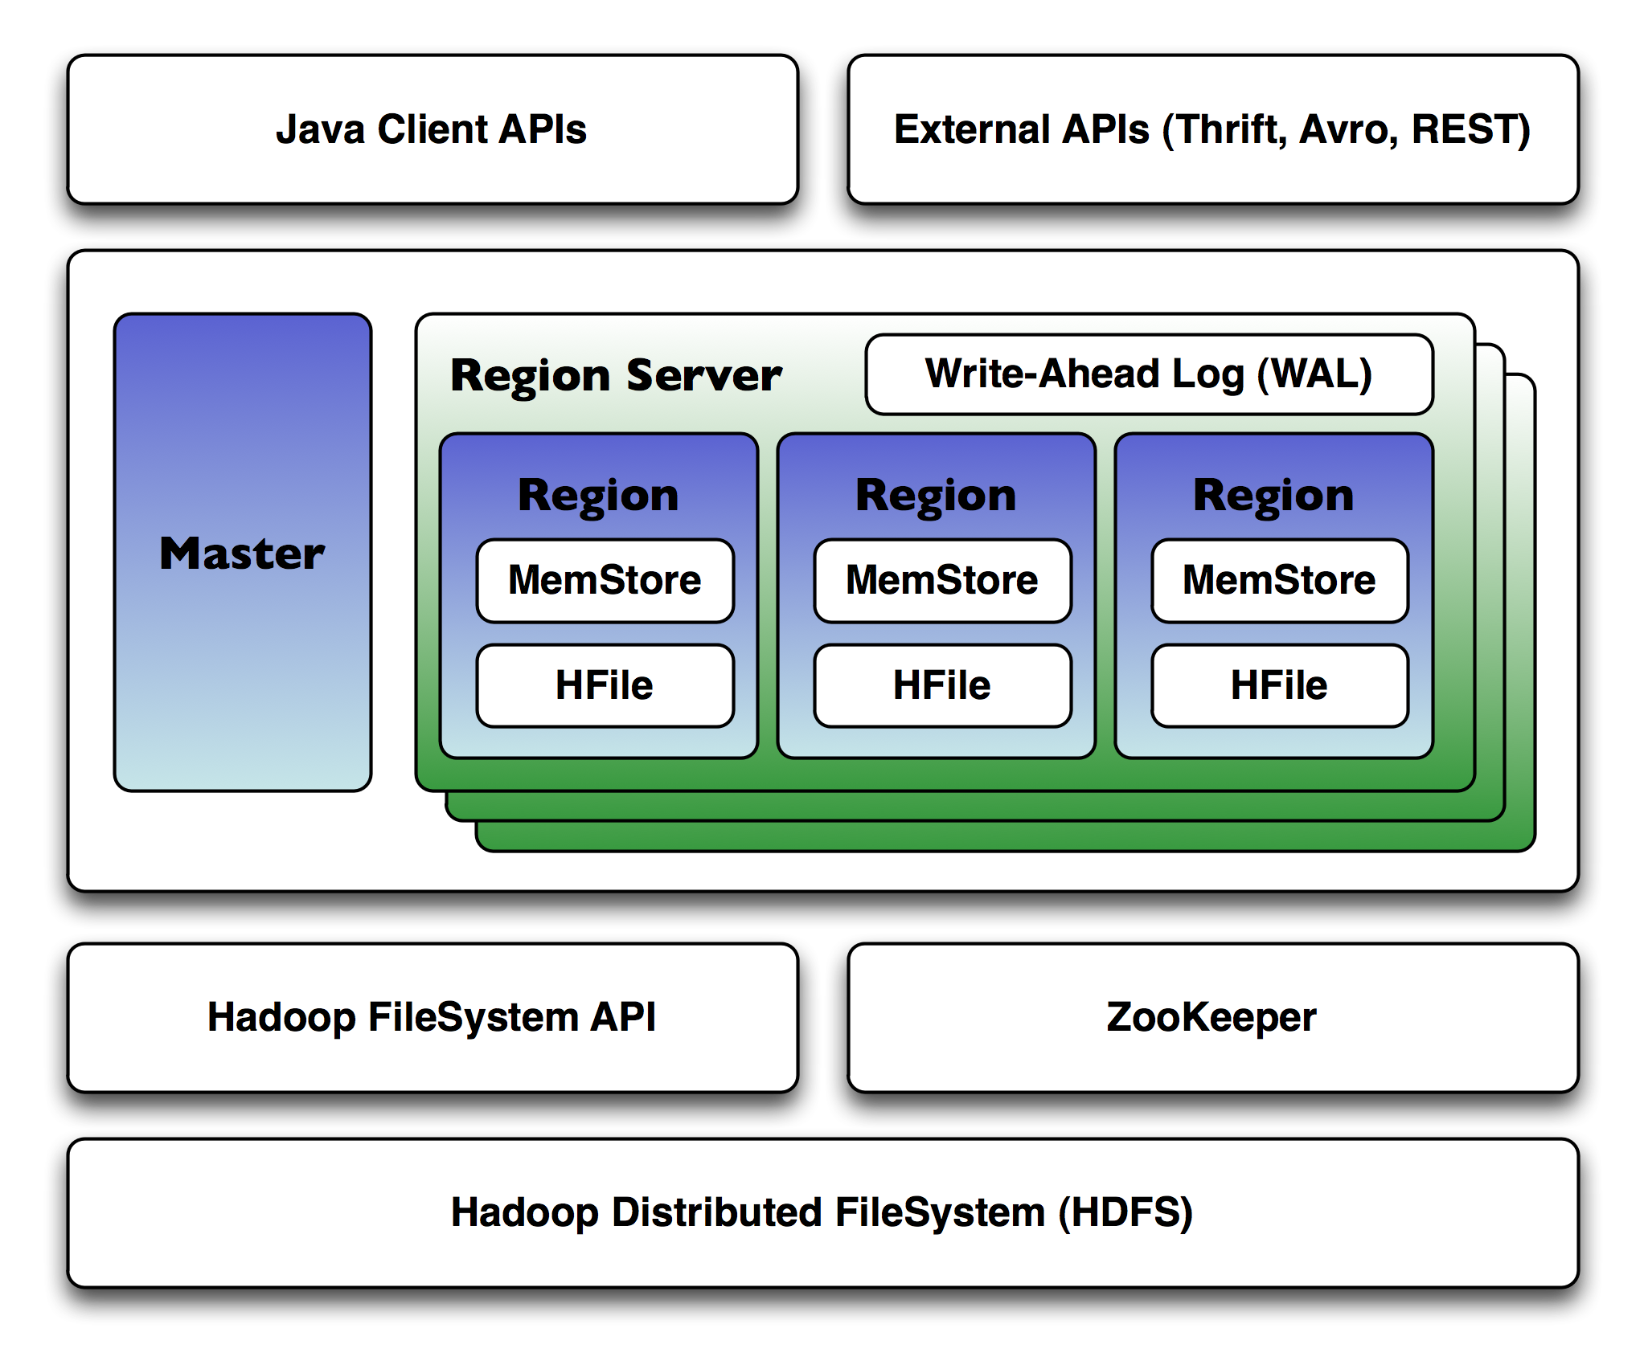
Apache HBase
Notes:
Schema-less
Linear and modular scalability
Strictly consistent reads and writes
Transaction only per row
No secondary indexes
Automatic and configurable sharding of tables
Automatic failover support between RegionServers
On top of HDFS
Easy to use Java API for client access

Slide 14
Big Data processing modes
Batch
  Long running jobs
Streaming processing
  One-at-a-time
  Micro batch

Slide 15
Apache Hadoop - MapReduce
Programming/Processing model
HDFS
Steps:
  Map
  Shuffle
  Reduce
Apache Hadoop ecosystem
  Pig
  Hive
  more

Slide 16

Map Reduce – word count

Slide 17
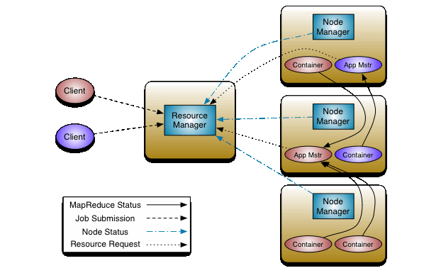
YARN

Slide 18
Apache Spark (batch processing)
Similar to MapReduce but faster
Resilient Distributed Dataset
Ecosystem
  Spark SQL
  MLlib
  GraphX
  Streaming
  Scala / R / Python / Java / SQL
Notes:
primary abstraction is a distributed collection of items called a Resilient Distributed Dataset (RDD)
Data to Reduce side directly RAM

Slide 19
Streaming processing
Batch
Processing
Streaming Processing
Solution
Real Time
Data Stream
Data Store
Alerts
Applications
Dashboards
Notes:
Transormations
Aggregations
Alerts / Trends / Fraud detection

Slide 20
Streaming processing Use Cases
Prevent security fraud
Optimize order routing
Predictive maintenance
Optimize personalized content
Optimize prices or offers
Prevent stock outs
Optimize bandwith allocation
Prevent application failures

Slide 21
Streaming processing frameworks
Apache Storm
Apache Spark Streaming
Apache Flink
Apache Samza

Slide 22
Apache Storm
Creator: Nathan Marz
Distributed real-time computation system for processing large volumes of high-velocity data
Most popular engine in industry
Characteristics:
  Fast
  Scalable
  Fault-tolerant
  Reliable
  Easy to operate
  Easy to develop

Slide 23
Storm modes
One-at-a-time processing (pure Storm)
  Very low latency
  Very simple development model
  At-Most-Once and At-Least-Once semantics
Micro batch processing (Storm Trident)
  Increased latency on event
  Better throughput for large rates (it depends)
  More complex development
  Exactly-Once semantics (per batch)

Slide 24
Storm Architecture
Worker
Supervisor
Worker
Zookeper
Worker
Supervisor
Worker
Nimbus
Zookeper
Worker
Supervisor
Worker
Zookeper
Worker
Supervisor
Worker
Master
Node
Cluster
Coordination
Node
Coordination
Processing
Worker
Notes:
Storm UI
Command line client
REST client

Slide 25
Storm concepts
Topology : A graph of computation
Tuple : Storm uses tuples as its data model
Stream : An unbounded sequence of tuples
Spout : A source of streams in a topology
Bolt : All processing in topologies is done in bolts
Stream Grouping : Defines how that stream should be partitioned among the bolt's tasks.

Slide 26
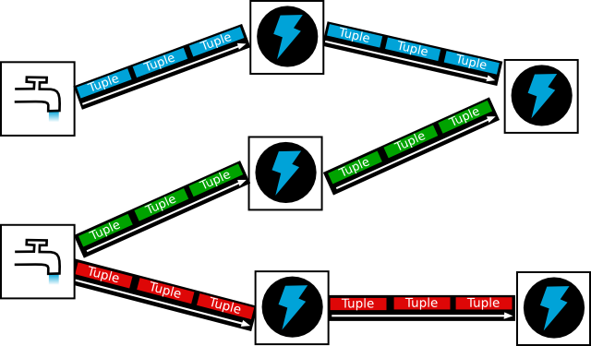
Storm topology

Slide 27
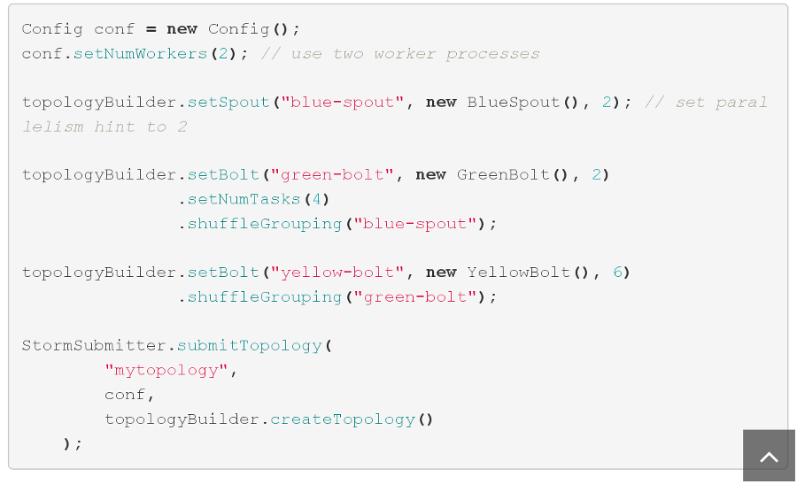
Storm topology example

Slide 28
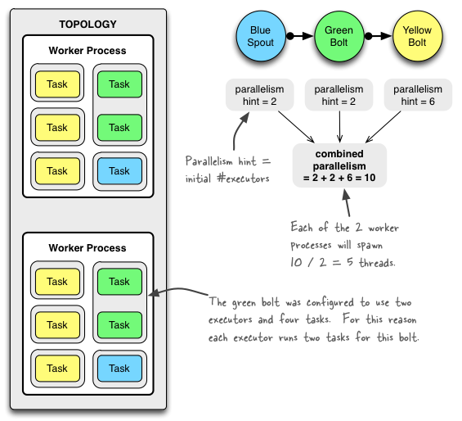
Storm topology parallelism

Slide 29
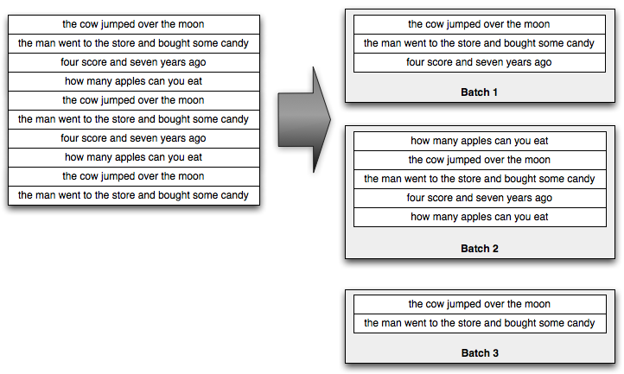
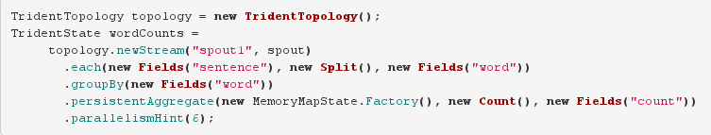
Storm Trident
Notes:
Framework built on top of pure Storm
Filters, Functions
Map, flatMap
Min, Max
Partitioning
State

Slide 30
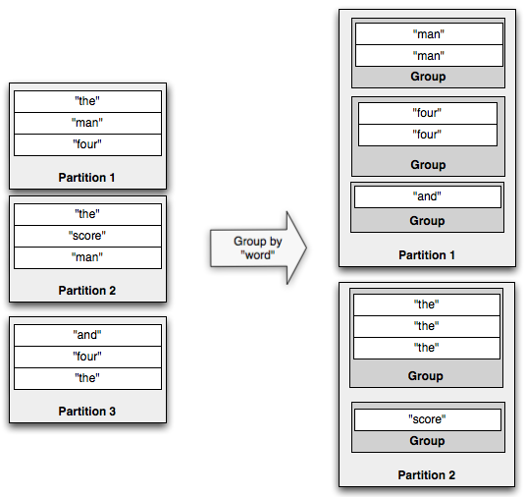
Storm Trident partitioning

Slide 31
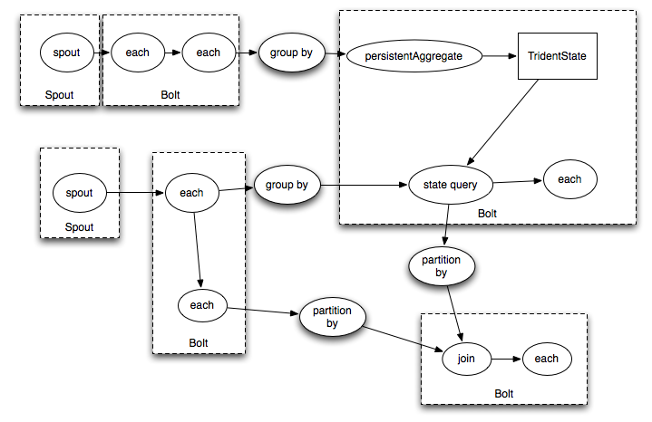
Storm Trident

Slide 32
Messaging Systems
Decouple processing from data producers
Buffer unprocessed messages
Models: queuing & publish-subscribe
Frameworks
  Kafka
  RabbitMQ
  ActiveMQ

Slide 33
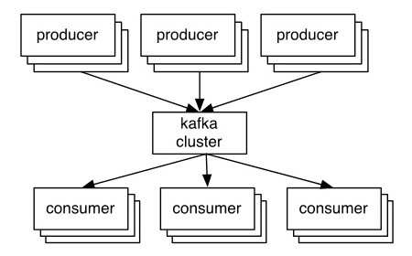

Apache Kafka
Distributed, partitioned, replicated commit log service
Maintains feeds of messages in Topics
Publish-Subscribe model
Notes:
Replication
Partitions
Zookeeper

Slide 34
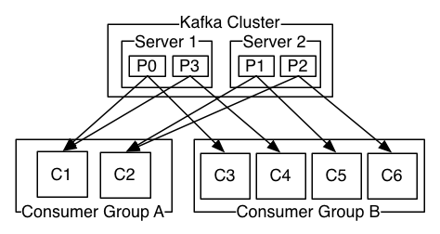
Apache Kafka
Consumers coordinate what to read
Consumer & Consumer Group
Brokers

Slide 35
Big Data Apps common problems
Integrate many input sources
Performance & Scalability
Complex infrastructure
Hard to debug
Difficult to select correct frameworks

Slide 36
Big Data Apps hints
Failure (HW or data) is a normal case
Design for scalability from day one
Queries drive schema design
Continuous Integration
Metrics from day one
Performance tests (real data)
Monitor
Appropriate people

Slide 37
Demo Architecture
TODOs

Slide 38
Thank YOU :-)
Questions ???

